Slide 1
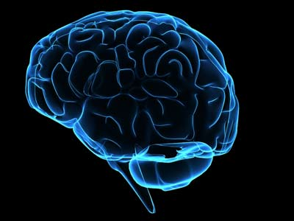
ARTIFICIAL NEURAL NETWORKS
Prof. D.M. VINOD KUMAR
Dept. of Electrical and Electronics Engineering
SR University Warangal
E-mail: vinodkumar.dm@gmail.com

Slide 2

HUMAN BRAIN

Slide 3
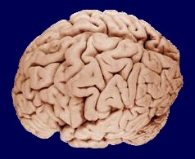
Human Brain

Slide 4
ARTIFICIAL INTELLIGENCE
𝗔𝗿𝘁𝗶𝗳𝗶𝗰𝗶𝗮𝗹 𝗜𝗻𝘁𝗲𝗹𝗹𝗶𝗴𝗲𝗻𝗰𝗲: • Automated Programming • Knowledge Representation • Expert Systems • Planning and Scheduling • Speech Recognition • Intelligent Robotics • Visual Perception • Natural Language Processing (NLP) • Problem Solving & Search Strategies
𝗠𝗮𝗰𝗵𝗶𝗻𝗲 𝗟𝗲𝗮𝗿𝗻𝗶𝗻𝗴: • K-Means Clustering • Principal Component Analysis (PCA) • Automatic Reasoning • Random Forest • Decision Trees • Ensemble Methods • Naive Bayes • Classification • Anomaly Detection • Reinforcement Learning
𝗡𝗲𝘂𝗿𝗮𝗹 𝗡𝗲𝘁𝘄𝗼𝗿𝗸𝘀: • Radial Basis Function Networks • Recurrent Neural Networks (RNN) • Autoencoders • Hopfield Networks • Modular Neural Networks • Adaptive Resonance Theory (ART)
𝗗𝗲𝗲𝗽 𝗟𝗲𝗮𝗿𝗻𝗶𝗻𝗴: • Convolutional Neural Networks (CNN) • Long Short-Term Memory Networks (LSTM) • Deep Reinforcement Learning • Generative Adversarial Networks (GAN) • Deep Belief Networks (DBN)

Slide 5


Slide 6
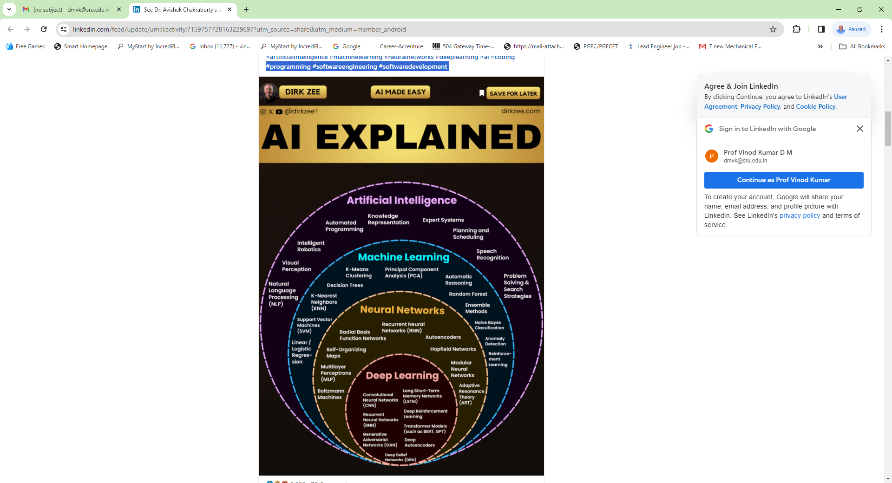

Slide 7
AI as the tool which helps to make smart choices and decisions based on smart predictive modelling.
Intelligence has TWO broad components:
(i) Acquiring Knowledge or Learning Knowledge.
(ii) Applying knowledge to ever changing situations.

Slide 8
Major success of AI is Self driving Cars.
Playing Chess.
Automatic translators
Statistics –based approaches to AI
Machine Learning + Automated Reasoning = Human like intelligence
(Learning & Reasoning)
Simulate human reasoning (Common Sense)
Common sense reasoning (CSR)

Slide 9
Automated Reasoning:
Logic and inference procedures play an important role in automated reasoning.

Slide 10
Machine Learning / Data Science
(AI) (Data base) (Big data)
The data could be captured, processed, mined and utilized.
Requirements:
Probability
Statistics
Data bases are required

Slide 11
Artificial Intelligence (AI)
AI is classified as
Artificial Neural Networks (ANNs)
Fuzzy Logic
3) Deep Learning (Deep Neural Networks)
4) Machine Learning
Computational Intelligence:
The study of adaptive mechanisms to enable or facilitate “intelligent” (decision making) behavior in complex and changing environments based on mathematical models of biological systems.

Slide 12
Artificial Intelligence (AI) :
Any technique that enables computers to mimic human behaviour.
Machine Learning:
Ability to learn without explicitly being programmed.
Deep Learning:
Extract patterns from data using Neural Networks.

Slide 13
TRADITIONAL PROGRAMMING
DATA
COMPUTER
OUTPUT
PROGRAM
MACHINE LEARNING
DATA
COMPUTER
PROGRAM
OUTPUT
(CURVE FITTING ALGORITHMS)
(EX: LINEAR REGRESSION)

Slide 14
Preamble
Man has learned much from studies of natural systems, using what has been learned to develop new algorithmic models to solve complex problems.
AI is the machine emulation of human thinking process

Slide 15
AI Techniques
Neural Networks:
Largely result of their ability to mimic natural intelligence. The Role model for the ANN is BRAIN.
Fuzzy Logic:
Fuzzy Logic is a method for representing information in a way that resembles natural human communication and for representing information in a way that resembles how humans reason with this information.
The Role model for the Fuzzy Logic is MIND

Slide 16
Evolutionary Computing (EC)
Evolutionary Computing mimic Darwinian theory of “Survival of Fittest” and “Principal of nature” to make search process.
EC began by lifting ideas from biological evolutionary theory into computer science and continues to look new biological research findings for inspiration.
Evolution is an optimization process where the aim is to improve the ability of individuals to survive.
EC is the emulation of the process of natural selection in a search process.

Slide 17
Collective behavior emerges from group of social insects such as Birds, Ants, Bees, Bacterial Foraging, Immunization System etc.

Slide 18
What about Intelligence?
Social behavior increases the ability of an individual to adapt.
Swarm Intelligence ≈ Collective adaptation
There is a relationship between adaptability and Intelligence.
Intelligence arises from interactions among individuals.
Each individual in a swarm behaves in a distributed way with a certain information exchange protocol.

Slide 19
Capabilities of the Brain
Pattern Recognition
Filter
Associative Memory
Scanner and Brain
Brain as a plastic organ

Slide 20
Artificial Intelligence (AI) is the branch of computer science concerned with making computers intelligent.
AI is a field of science which concerns itself with designing and developing software that is capable of processing knowledge and applying that knowledge to manipulate an ever changing situations.

Slide 21
AI is the machine emulation of human thinking process.
The human brain is a source of natural intelligence and a truly remarkable parallel computer.
Human brain is the most complex machine on earth. The brain did not simply retain a copy of the picture as a scanner would, but and organize the knowledge on the basis of meaning.
The brain is a fantastically plastic organ, able to constantly reprogram itself to represent and understand the world.

Slide 22
Intelligent control was proposed to increase the flexibility and extend the range of the automatic control system.
The intelligent control used techniques from the fields of artificial intelligence operational research & dynamic control to sense, reason, plan and act inn an intelligent or smart manner. This list could be augmented now to include computer science.
Intelligent systems must operate in hazardous, ill-defined, time varying environments and complete their assigned tasks safely.

Slide 23
 | Von Neumann Computer | Biological Neural System
Processor | Complex High speed One or few | Simple Low speed A large number
Memory | Separate from a processor Localized | Integrated into processor Distributed
Computing | Centralized Sequential Stored programs | Distributed Parallel Self-learning
Operating Environment | Well-defined Well-constrained | Poorly defined Unconstrained

Slide 24
Brain
Occupies 2% of body mass.
At rest, consumes 20% of the body’s oxygen.
Consumes 20 watts of power.
>10¹² neurons.
10¹³ -10¹⁹ switchings /sec.

Slide 25
Computer
It requires few Watts of power.
Air conditioned environment, dust free environment.
>10⁹ transistors, occupying 1mm² silicon area (2 to 3%).
>10¹⁸ switchings /sec.
Nature of architecture – Von Neumann.

Slide 26
AI Based vs. Traditional Programming
Traditional (Algorithmic programming):
Programme represents knowledge
Program
&
Knowledge
AI Based: Knowledge and Program separate.
Program acts as interpreter.
Program
Knowledge

Slide 27
Biological Neuron
Biological neuron is composed of
  A cell body (nucleus)
  Dendrites (receivers)
  Axon (transmitter)
  Synapse: functional unit between two neurons (an axon strand of one neuron and a dendrite of another).

Slide 28
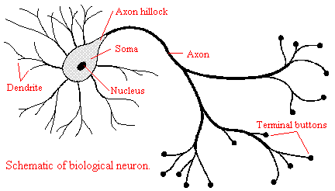
Biological Neuron

Slide 29
Modeling of a Neuron
I
N
P
U
T
x1
w1
x2
w2
Non-Linear
Function
Σ
Net
Output
f (Net)
wn
xn
Net = x1.w1 + x2.w2 + ………..+ xn.wn

Slide 30

NEURON
The neuron is the basic information processing unit of a Neural Network. It consists of:
  A set of links, describing the neuron inputs, with weights W₁, W₂, …, W_{m}
  An adder function (linear combiner) for computing the weighted sum of
  the inputs (real numbers):
  Activation function (squashing function) f for limiting the amplitude of the neuron output.

Slide 31
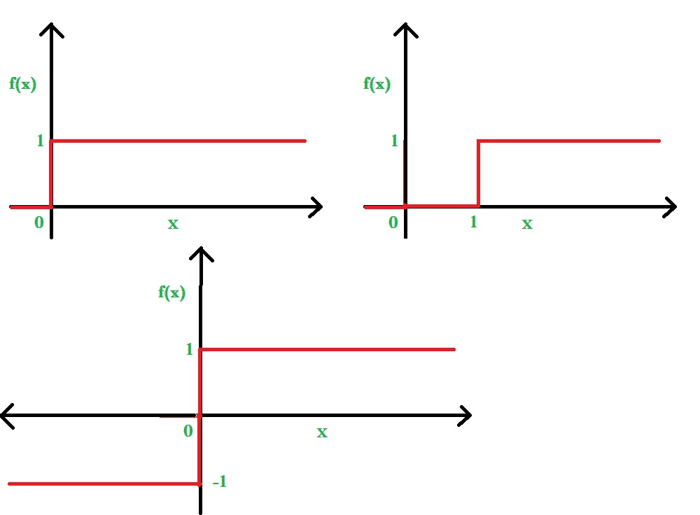
Linear Activation Functions

Slide 32
Non-Linear Functions
Output = f(x)
Output = 1/(1+e^{-x})
f(x)
0
Input (x)
Output = e^{[-(x-µ)2/2σ2]}
Fig. Sigmoidal Function
f(x)
Output =
(1-e^{-x})/(1+e^{x})
x
Fig. Gaussian function
x
Fig. Tan hyperbolic function

Slide 33
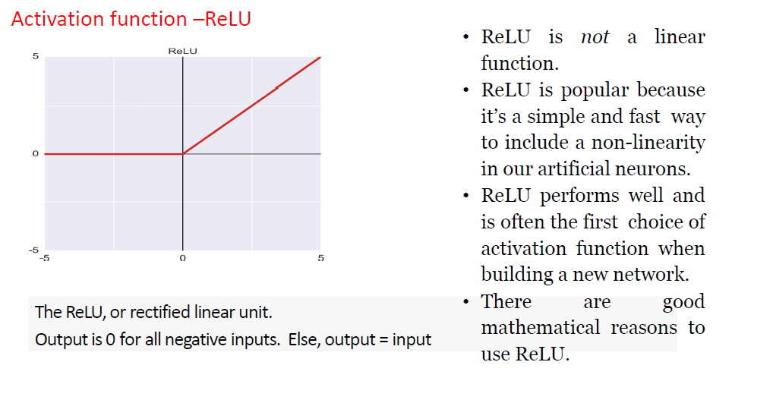
ReLU Activation Function

Slide 34
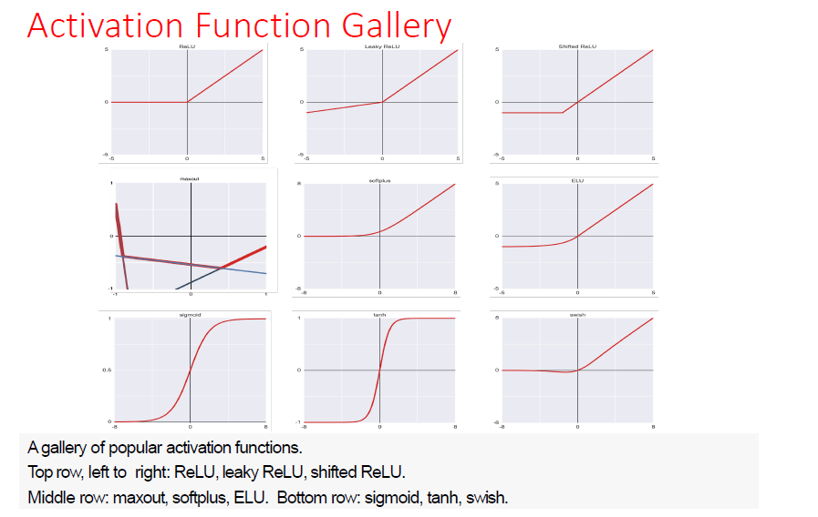
Activation Function Gallery

Slide 35
Definition
Artificial Neural Network
A Neural Network is a massively Parallel Distributed Processor that has a natural property for storing experimental knowledge and making it available for use. It resembles the BRAIN in two respects.
Knowledge is acquired by the Neural Network Through Learning Process
Inter Neuron Connection Strengths known as Synaptic Weights are used to store the Knowledge

Slide 36
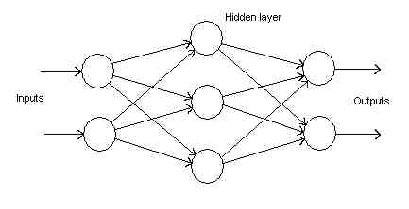
Artificial Neural Network
Feed Forward Neural Network

Slide 37
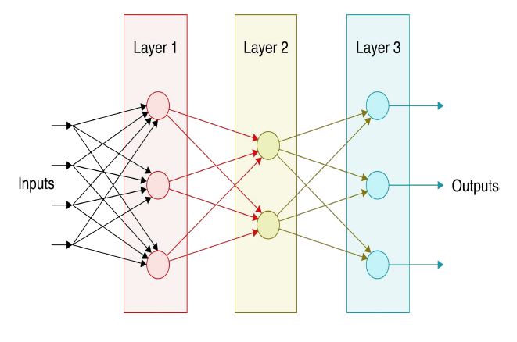
Feed Forward Neural Network

Slide 38
Feedback Neural Network
(Recurrent Neural Network)

Slide 39

Single Layer Neural Network
Exclusive-OR problem
One of Minsky’s more discouraging results shows that a single layer Perceptron cannot simulate a simple exclusive-OR function
x
w1
∫
Net
F
Out
y
w2
F is simple threshold producing a zero for out when Net is below 0.5 and 1 when Net is equal to or above it. The neuron then performs the following calculation :
Net = xw₁ + yw₂
xw₁ + yw₂ = 0.5

Slide 40
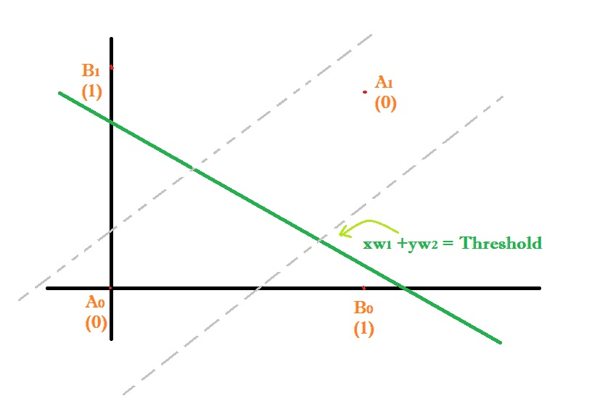
Exclusive-OR Truth Table
Point | X value | Y value | Desired output
Ao | 0 | 0 | 0
Bo | 1 | 0 | 1
B1 | 0 | 1 | 1
A1 | 1 | 1 | 0

Slide 41
Overcoming the Linear Seperability Limitation
The serious representational limitation of single-layer network could be overcome by adding more layers.
For example, two layer networks may be formed by cascading two single layer networks. These can perform more general classifications, separating those points that are contained in convex open or closed regions.
“A convex region is one in which any two points in the region can be joined by a straight line that does not leave the region.”

Slide 42
Characteristics of ANNs
ANNs are biologically inspired.
ANNs are organized in a way that may (or may not) be related to the anatomy of the brain.
Learn from experience.
Generalize from previous examples to new ones.
Abstract essential characteristics from inputs containing irrelevant data.
A neuron was designed to mimic the first-order characteristics of the biological neuron.

Slide 43
LEARNING LAWS
Supervised Learning:
Input x
ANN
W
Y (actual
Output)
Error (D-Y) signal
Error signal
generator
D (desired
Output)
2. Unsupervised Learning:
ANN
W
Y (actual
Output)
Input x
3. Reinforcement Learning:
Input x
ANN
W
Y (actual
Output)
Error signal
Error signal
generator
R
(Reinforcement
Signal)

Slide 44
Reinforcement Learning
This learning process is similar to supervised learning. In the case of Supervised learning, the correct target output values are known for each input pattern. But in some cases, less information might be available.
For example: the network might be told that its actual output is only “50% correct” or so. Thus here only critic information is available not the exact information.

Slide 45
Unsupervised Learning
Unsupervised classification procedures are often based on some kind of clustering strategy, which forms groups of similar patterns.
The clustering technique is very useful for pattern classification problems.
For clustering procedure, it is necessary to define a similarity measure to be used for evaluating how close patterns are.

Slide 46
Neural Network Learning Laws
Supervised Learning
(i) Perceptron Learning
(ii) Delta Learning
(iii) Widro-Hoff Learning
(iv) Correlation Learning and (v) Outstar Learning
Unsupervised Learning
(i) Hebbian Leaning and
(ii) Competitive Learning (Winner-Takes-all Learning)

Slide 47
Supervised Learning Rules
Percpetron Learning Rule
(Threshold Logic)
Error Signal = δ = ( d_{i} – O_{i )}
Δw_{ij} = η [ d_{i} – O_{i} ] x_{j}
_{Delta Learning Rule}
(Continuous Activation Function)
Δw_{ij} =η[ d_{i} – O_{i} ] f ‘ (W_{ij}^{t}x) x_{j}
Widrof-off Learning Rule
(No Activation function)
Error Signal = δ = ( d_{i} – W_{ij}^{t}x)
Δw_{ij} = η [ d_{i} – W_{ij}^{t}x ] x_{j}

Slide 48


Unsupervised Learning Rules
Competitive Learning or Winner-Take All Learning Rule
x_{i}
Oi
w_{mi}
w_{mj}
x_{j}
w_{mn}
Oj
Winning Neuron
x_{n}
On

Slide 49
Δw_{m} = η (x - w_{m})
Where η is learning rate
x is the input
w_{m} is Winning neuron weights

Slide 50
Hebbian Learning
Outi
Outj
w_{ij}
i
j
Δw_{ij} = η (out_{i} - out_{j})
Where Δw_{ij} is the change in specific weight connecting neuron-i to neuron-j
out_{i} = out put of neuron-I
out_{j} = output of neuron-j

Slide 51
Updating of Weights
W_{new} = W_{old} + ΔW

Slide 52
Requirement of Learning Laws
Learning corresponds to parameter changes.
The learning law should lead to convergence of weights.
The learning or training time for capturing the pattern information from samples should be as small as possible.
Learning should be able to capture complex non-linear mapping between input and output pattern pairs, as well as between adjacent pattern in a temporal sequence of patterns.
Learning should be able to capture as many patterns as possible into the network. That is, the pattern information storage capacity should be as large as possible for a given network.

Slide 53
Objective of Learning
The objective of any Learning Law is that it should eventually lead to a set of Weights which will capture the pattern information in the training set data.

Slide 54
Neural Networks
UNSUPERVISED
Self Organizing Map
Adaptive
Neocognitron
SUPERVISED
Perceptron
Multilayer Perceptron
Temporal Dynamic model
There is no learning required for the fixed weight networks, so learning model is supervised or unsupervised.
Supervised training
Classification
Unsupervised training
Approximation

Slide 55
The current interest in neural networks is largely a result of their ability to mimic natural intelligence.
The neural networks have emerged as a powerful technique for
  Pattern recognition
  Pattern classification
  Function approximation
  Optimization
  Prediction
  Automatic control

Slide 56
Multilayer Feedforward Neural Networks
Back Propagation Algorithm (BPA)
Initialize the connection weights Wji.
Initialize the iteration count i.
Read in an input pattern p.
Starting from the nodes in the first hidden layer, compute the neuron output using equations,
  netj = Σi (Wji * Xi)
  Oj = 1/(1+ e^-netj) = fj(netj)
Update the connection weights using equations
  ΔWji(p) =η*δpj*Opi+α*ΔWji(p-1)
  Where for output nodes δpj = (tpj-Opj)*Opj*(1-Opj)
  and for other nodes δpj = (Σk δpk*Wkj)*Opj*(1-Opj)

Slide 57
Repeat (steps 3-5) until all parameters in the training set have been considered (p=P)
Compute the error function E(i) for the present iteration using the following equation:
  E(i) = Σ E(p) for p=1 to P
  = Σ ½ Σ (tpj – Opj)² for j=1 to m, for p=1to P
If there is significant improvement in the error function i.e., IE(i) – E(i-1)I <ε then print out weights and stop.

Slide 58
Radial Basis Function (RBF) Neural Network
Topology:
RBF Neural network consists of three layers.
(i) Input layer
(ii) Hidden Layer (Consists of Gaussian Function)
(iii) Output layer (Consists of Linear function)

Slide 59
Training of RBF
Training of RBF Neural Network consists of:
(i) Unsupervised Training (between input layer and hidden layer)
(ii) Supervised training (between hidden layer and output layer)

Slide 60
Gaussian density function defined by
A Centre (mean)
A Width parameter (Standard deviation)
In unsupervised training: Centre and Width parameter of each hidden neuron must be computed.
In supervised training weight matrix must be trained.

Slide 61
Computation of RBF Centers:
(k-means clustering Algorithm)
(1) Initialize the centre of each cluster to a different randomly selected training pattern.
(2) Assign each training pattern to the nearest cluster. This can be accomplished by calculating the Eucledian distances between the training patterns and the cluster cnetres.

Slide 62
Cont…
(3) When all training patterns are assigned calculate the average position for each cluster centre. They become new cluster centers.
(4) Repeat steps (2) and (3) until the cluster centers don not change during the subsequent iterations.

Slide 63
HOW TO ATTACK A PROBLEM
Training:
(i) Generate training patterns
(ii) Normalize the training patterns
X_{i} ’ = [(x_{i} – x_{imin}) *0.8)/(x_{imax} – x_{imin})] +0.1
(iii) Initialize the Weight Matrix
(iv) Select a Suitable Non-linear function
(v) Map the input-output patterns according to the specified algorithm
(vi) When error becomes small stop Training
Testing
(vii) Test the Neural Network with Novel input pattern

Slide 64
FUZZY LOGIC = COMPUTING WITH WORDS
Computing with words is a methodology in which words are used in place of numbers and reasoning.
The Role model for Computing with Words is the human mind.

Slide 65
Fuzzy Logic
In traditional sense, computing involves manipulation of numbers and symbols.
By contrast humans employ mostly words in computing and reasoning, arriving at conclusions.
Fuzzy sets model human reasoning and thinking in that they can handle imprecise information.

Slide 66
Theoretical Reasons for Fuzzy Control
Fuzzy control is a model-free approach.
Fuzzy control provides non-linear controllers.
Making effective use of all the available information

Slide 67
Practical Reasons for Fuzzy Control
It is easy to understand.
It is simple to implement (Fuzzy VLSI Chips)
It is inexpensive to develop.
Fuzzy control is an approach that has a high (Performance/cost) ratio.

Slide 68
Fuzzy control should be useful in situations where
There is no acceptable mathematical model for the plant.
There are experienced human operator who can satisfactorily control the plant and provide qualitative control rules in terms of range and fuzzy sentences.
Fuzzy controllers are supposed to work in situations where there is a large uncertainty or unknown variations in plant parameters and structures.

Slide 69
Fuzzy Logic Controllers (FLCs) are rule-based systems capable of mimicking the “rule-of-thumb” approach used by humans in process control.
This human rule-of-thumb approach is modeled using rules that incorporate fuzzy linguistic terms, such as expressions like “high” and “low”.
These linguistic terms are described by membership functions.
Linguistic terms have been incorporated into rule-based systems to form Fuzzy Logic Controllers (FLCs).

Slide 70

The important concept in fuzzy logic is “ Degree of Membership”- A number which describes the extent to which an element is in a set.
The degree of membership of fuzzy set is defined by “Membership functions”.
The “Membership functions” provides a direct linkage between fuzzy logic and fuzzy sets. It is defined as
where x is a member of A and
A is some propositional or predicate class.

Slide 71
Definitions
Fuzzy Logic
A branch of logic that uses degree of membership in sets rather than a strict True/False membership.
Degree of Membership
The “confidence” or “ certainty” expressed as a member from 0 to 1, that a particular value belongs in a fuzzy set.

Slide 72
Definitions Cont….
Membership Function
A formula used to determine the fuzzy set to which a value belongs and the degree of membership in that set.
Linguistic Variables
Common Language terms used to describe a fuzzy set, such as HOT, SLOW, MEDIUM etc.,

Slide 73
Fuzzy Logic Controller
The Fuzzy Logic Controller has Three modules.
Fuzzification
Inference Engine -- Rule Base
Defuzzification

Slide 74
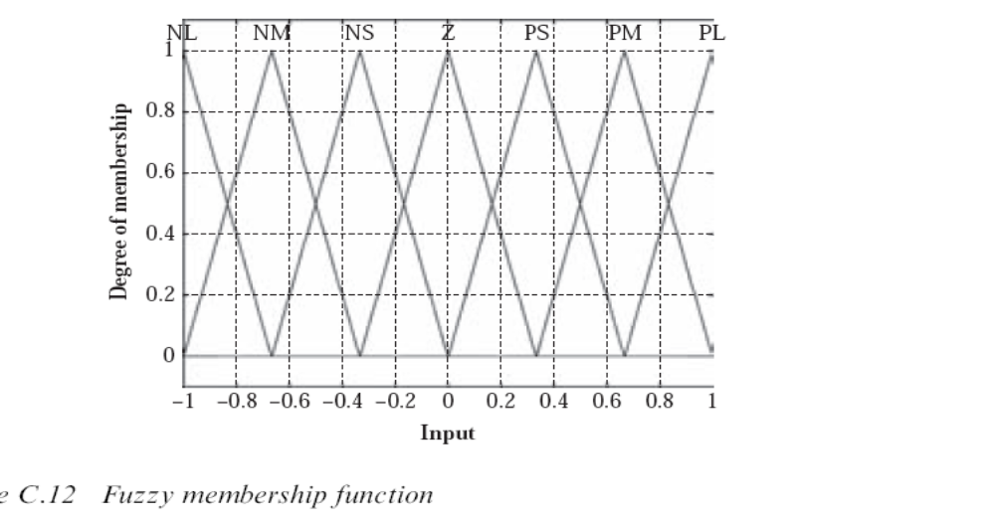
Fuzzification

Slide 75
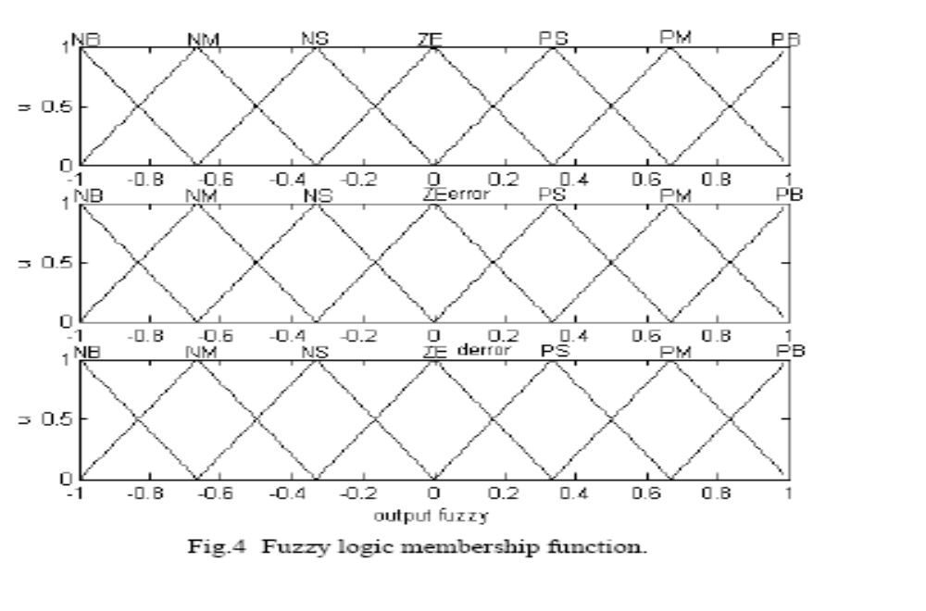
FUZZY LOGIC MEMBERSHIP FUNCTIONS

Slide 76
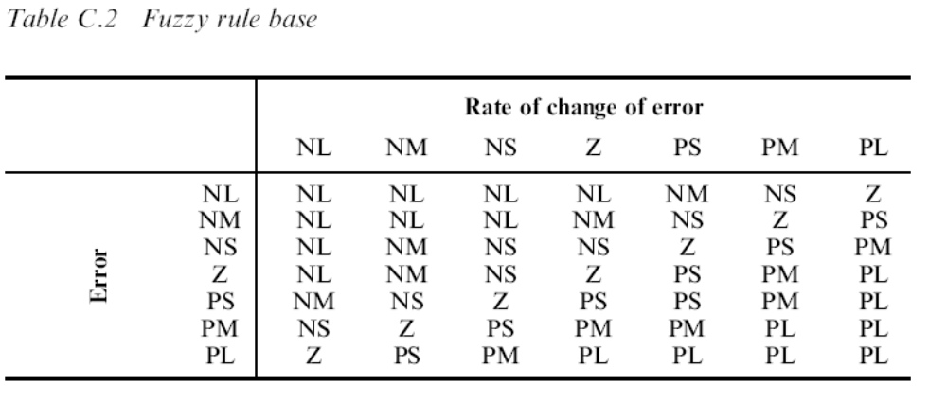

Slide 77
Methods of Defuzzification
Centre of Gravity Defuzzification
Centre-of-sums Defuzzification
Centre of Largest Area Defuzzification
First of Maxima Defuzzification
Middle of Maxima Defuzzification
Height Defuzzification

Slide 78
Maximum Power Point Tracking (MPPT) using Fuzzy Logic Controller for PV Systems
It is crucial to operate PV energy conversion system near maximum power point to increase the output efficiency of PV system.
Maximum power operating point changing with insolation level and temperature.
The tracking control of maximum power point is an important issue.

Slide 79
Cont…
PV system cannot be modeled as a constant DC current source because its output power is varied depending on the load current, temperature and irradiation.
The MPPT is adopted to track the maximum power point in the PV system.
The model of solar cell can be considered as P-N semiconductor junction ; when exposed to light, the DC current is generated.

Slide 80
Cont…
The Generated current depends on solar irradiance, temperature and load current.

Slide 81
MPPT using FLC
Input variable of the FLC are:
The Change in PV array power (∆P_{pv} ) and
The Change in PV array current (∆I_{pv} )
P^{k}_{pv} = V^{k}_{pv} . I^{k}_{pv}
∆P^{k}_{pv} = P^{k}_{pv} - P_{pv}^{k-1}
∆I^{k}_{pv} = I^{k}_{pv} - I_{pv}^{k-1}

Slide 82
Cont..
Output variable of the FLC:
    The magnitude of the change of boost converter current reference (∆I_{ref} )
    The current reference is the command for controlling the current drawn from the PV.

Slide 83
Cont…
The input and output variable are to be fuzzified.
The responses can be compared with the conventional MPPT algorithms (viz., Perturb and Observation etc.,)

Slide 84
EVOLUTIONARY ALGORITHMS
SWARM INTELLIGENCE ≈
COLLECTIVE ADAPTATION
A population of interacting individuals that optimizes a function or goal by collectively adapting to the local and/or global environment.
Originated from the study of colonies or swarms of social organizations.

Slide 85
Optimization methods can be broadly classified into (i) Exact Methods and (ii) Heuristic Techniques.
Exact methods are usually based on the strict mathematical analysis, which may become less effective or even impractical for target problem when system becomes large and complex.
In these situations, heuristic methods may be a wise choice.

Slide 86
The traditional approaches include Linear Programme, Non-linear programming, Dynamic Programming, Geometric Programming so on.
These methods are usually rigorous in mathematical analysis but are weak in coping with high non-linearity.
They often suffer from the “Curse of Dimensionality”.
Due to high complexity and high non-linearity of many practical problems, meta-heuristic based on guided stochastic search have been proposed as an alternative to traditional analytical approach.

Slide 87
Computation Intelligence (CI) based search algorithms are a set of commonly used meta-heuristics which can be further classified into (i) Population based and (ii) non-population based intelligent search.
Meta – Greek Word – for upper level methods.
Heuristics – Greek Word -- for Art of discovering new strategies to solve problems.

Slide 88
Meaning of Meta-heuristic
In Computer Science, Metaheuristic designates a computational method that optimizes a problem by iteratively trying to improve a candidate solution with regard to a given measure of quality.
Metaheuristic make few or no assumptions about the problem being optimized and can search very large spaces of candidate solutions.
However, Metaheuristic do not guarantee an optimal solution is ever found.

Slide 89
SHORT COMINGS OF TRADITIONAL OPTIMIZATION METHODS
Stuck at local optima /Pre-mature convergence
Requirement of existence of derivatives of objective and constraint functions
Requires mathematically well defined objective and constraint functions
Difficult to handle mixed variables
Difficult to handle multiple conflicting objectives

Slide 90
ADVANTAGES OF METAHEURISTIC METHODS
Many Metaheuristic algorithms implement some form of stochastic optimization.
Metaheuristic methods are derivative free and direct search methods.

Slide 91
History of Metaheuristics
1965: First Evolution strategy
1975: First Genetic Algorithm
1983: Simulated Annealing
1986: Tabu Search
1991: Ant Colony Optimization
1997: Variable Neighborhood search
2000⁺: Parallel and Distributed Computing in Metaheuristics

Slide 92
Classification of Metaheuristics
Nature inspired (Swarm intelligence from biology) Vs Non-nature inspired (Simulated annealing from Physics).
Deterministic (Tabu, local search) Vs Stochastic (Genetic Algorithm, Particle Swarm Optimization) metaheurtistics.

Slide 93
Deterministic: Some initial solution will lead to some final solution after several search steps.
Stochastic: Some initial solution will lead to different final solutions due to some random rules in the algorithm.

Slide 94
Population based algorithms
(Multiple Solution based methods)
Genetic Algorithm
Ant Colony Optimization
Artificial Bee Colony
Particle Swarm Optimization (PSO)

Slide 95
Non-population based methods
(Trajectory based methods)
(Single solution based methods)
Tabu Search
Simulated Annealing
Gravitational Search Algorithm
Tree Search Algorithm

Slide 96
“Trajectory based methods” are heavy on intensification while “Population based methods” are heavy on diversification.
Diversification & Intensification of the search are the two strategies for search in metaheuristics. One must strike a balance between them.
Diversification explore solution space whereas Intensification should be able to find local optima.
Therefore Quality Vs Time trade off.

Slide 97
The General evaluation results of Metaheuristic methods are:
Comparison with Optimal Solution.
Ability to find good optimal solution.
Comparison with other Metaheuristic methods.
Reliability and Stability over several runs
Average gap between solution while approaching the (local) optima.
Statistical tools (Standard deviation of solutions and confidence intervals)
(v) Reasonable computational time.

Slide 98
Properties of Metaheuristic Techniques
Metaheuristics are strategies that “guide” the search process.
The goal is to efficiently explore the search space in order to find (near) optimal solutions.
Metaheuristics are not problem specific.
They may incorporate mechanism to avoid getting trapped in confined areas of the search space.
Techniques which constitute metaheuristic algorithms range from simple loacl search procedures to comples learning process.

Slide 99
IF YOU HAVE HAMMER IN YOUR HAND EVERY THING LOOKS LIKE A NAIL

Slide 100
THANKS

